Slide 1



Air Quality Monitoring and Analysis Based Predictive System
R24-078
21/2/2024

Slide 2




Meet Our Team !
Inthikhaff M. I. M
IT21058028
Rimas M. J. M
IT21003714
Kumari J. M. D
IT21152832
Pasan M.G. R
IT21057588

Slide 3

Content
Overall Introduction
Research Question
Objectives
Main Objective
Specific Objectives
Overall System Architecture
Individual Components

Slide 4

INTRODUCTION
Air Quality or in other words quality of the breathing air around us is a highly valuable luxury that people should have but unfortunately, more than two-thirds of the people who live on our planet do not have it.
Sri Lanka is facing a serious air pollution problem that severely impacts the daily life of every Sri Lankan. The main source of ambient air pollution in Sri Lanka is vehicular emissions.
Both indoor and outdoor air pollution has grown into an alarming state all over the world.
Although air pollutants are many, the most important are Particulate Matter (PM), Carbon Dioxide (CO2), Carbon Monoxide (CO), Ground level Ozone (O3), Nitrogen Oxides, (NOx), Sulfur Oxides (SOx), and Lead (Pb) which is found in the ambient air.
Now it has begun a major environmental health problem that affects people in both developed And developing countries.

Slide 5

Research Question
How can air quality monitoring and analysis be integrated into a predictive system to forecast and mitigate environmental risks?
How can we find a solution for students who are affected by air pollution ?
How can we encourage people to travel with minimal levels of pollution ?
How can we enhance transparency and raise awareness among the public regarding air pollution and pollution levels?

Slide 6




OBJECTIVES
Sub Objectives
Main Objective
Sensor based device creation and value accuracy.
This research proposes a prototype which uses an air quality monitoring device and a mobile application
Pollution levels prediction
Real-time pollution map
People’s awareness is also the main objective of this research, and it helps people who are suffering from respiratory diseases, kids and older persons to avoid the most polluted areas by identifying highly polluted areas when traveling.
Real-time route generation is based on pollution.

Slide 7
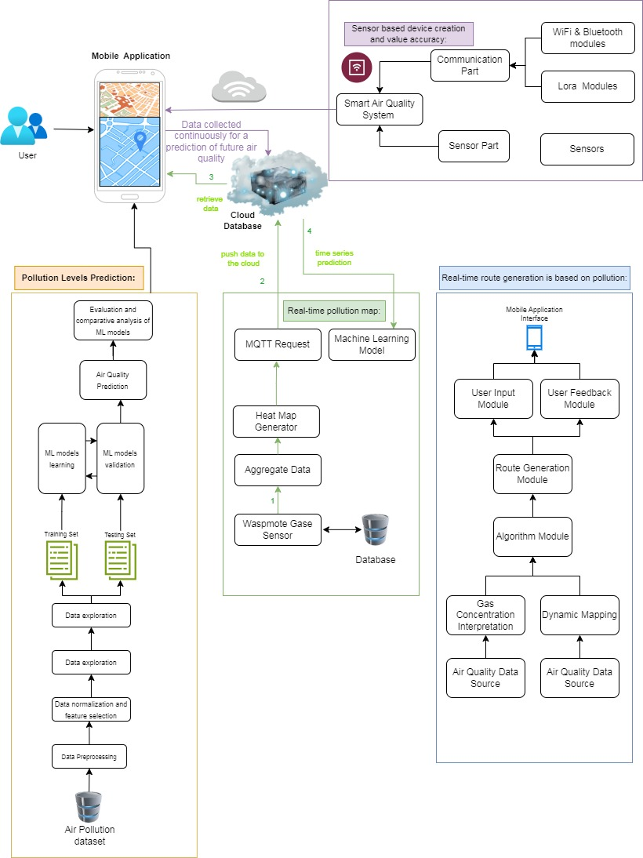
Overall System Architecture

Slide 8
05
Individual Components

Slide 9

IT21003714 |Rimas. M.J.M
Sensor based device creation and value accuracy.......
IT21003714 | RIMAS.M.J.M | RP24-78

Slide 10
Component 1
Introduction
Research Questions
Research Gap
Specific and sub objectives
System Diagram
System, personal, and software specification Requirements
WBS
Gannt Chart
Budget
References
IT21003714 | RIMAS.M.J.M | RP24-78

Slide 11
INTRODUCTION
These devices are considered automated devices that measure (ch4), (CO) and record and using MQ7,MQ4 information using sensors. With the real-time data monitoring ability of IoT [1]
We employed MQ4 and MQ7 sensors to measure Methane (CH4) and Carbon Monoxide (CO) gases. The sensors' conductivity increases with higher gas concentrations.
Using Arduino Uno, we converted the analog sensor readings to sensor voltage.
This voltage was then transformed into Parts per Million (PPM) concentrations using sensitivity calibration curves. Equations for CH4 and CO concentration relationships were derived Using the graphical analysis software, Engauge Digitizer
IT21003714 | RIMAS.M.J.M | RP24-78

Slide 12
INTRODUCTION
The implemented system ensures real-time monitoring by transmitting data every minute to a database.
Location identification is achieved through predefined terminal numbers, reducing data packet size.
The Arduino Uno board manages the data processing code, handling sensor inputs and facilitating secure communication with the server, ensuring the efficiency and accuracy of the air quality monitoring system.
IT21003714 | RIMAS.M.J.M | RP24-78

Slide 13
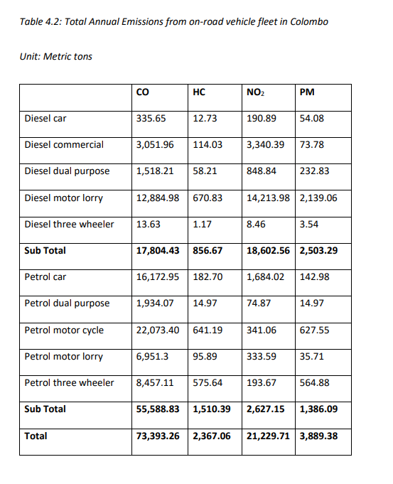
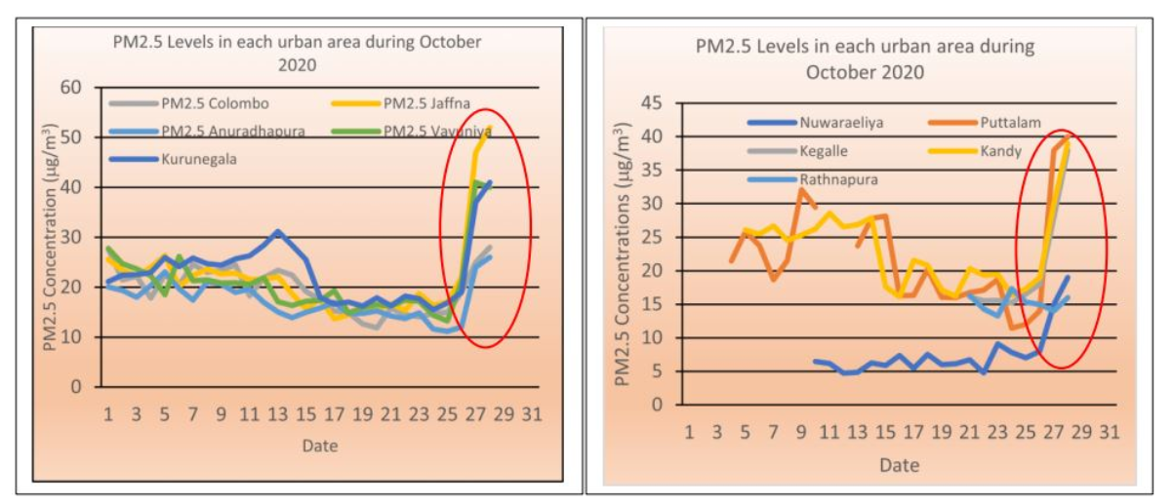
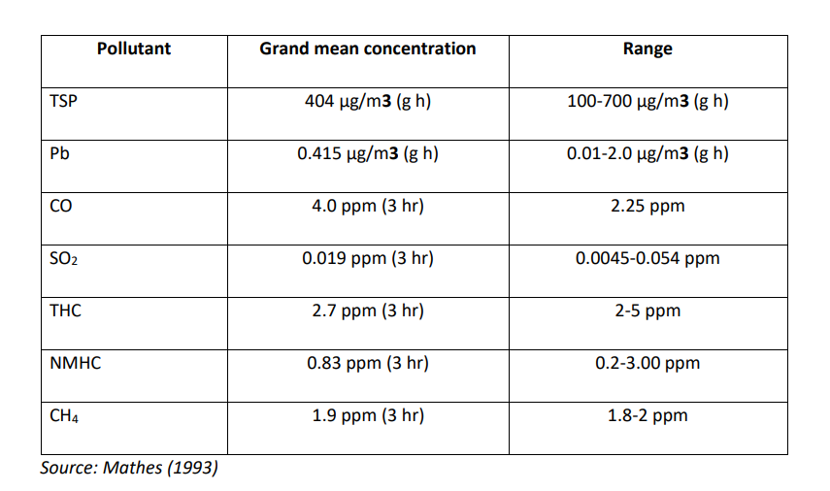
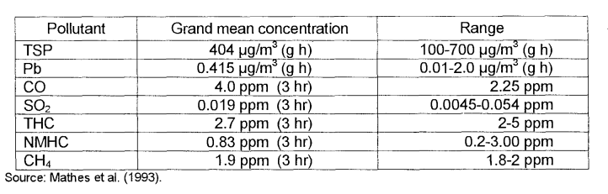
INTRODUCTION
IT21003714 | RIMAS.M.J.M | RP24-78

Slide 14

Research Question
How implementation IOT devices ?
How to get more accuracy in values using different senses?
How to transfer collect the data to databases ?
IT21003714 | RIMAS.M.J.M | RP24-78

Slide 15


Research Gap
First-ever mobile-based Sensor based device creation and value accuracy with comparable visuals application in Sri Lanka
Sent alert to user Notifications concentration Level in real time
Comparison of existing systems
Sensor based Device creations
For measure air pollutions’
Sensor based Device creations
For real time dynamics map
Sensor based Device creations
For real time Route map
Sent alert to user when concentration level is high
Mobile Application
Application
Reference
Research A
Research B
Research C
Proposed System
IT21003714 | RIMAS.M.J.M | RP24-78

Slide 16


Specific and Sub Objective
USE THE IoT DEVICES TO GET ACCURATE reding of (ch4) and (co) concentration level
Sensor based device creation and value accuracy
Use the IoT devices to get accurate reding of route distances
USE THE IOT DEVICES TO GET ACCURATE dynamic map
enhances user notification capabilities
IT21003714 | RIMAS.M.J.M | RP24-78
2/21/2024

Slide 17







System , Personnel and Software Specification Requirements
Software
Requirements
React Native
MongoDB
Note-J
Postman Api
Arduino IDE
Visual Studio Code
System Requirements
Non-Functional
Requirements
System should be able to send real time mobile push notifications to requested user when pollution level concentration is high
Store threshold values in database
Arduino Code Implementation
Real-time Data Transmission and Location Identification
Should respond Realtime.
Should properly work as a mobile cross platform application.
Should have high security.
Application should be reliable
Interfaces should be more user-friendly.
Personnel
Requirements
Sensor MQ3,MQ7
Wifi module
IoT Devices
IT21003714 | RIMAS.M.J.M | RP24-78
2/21/2024

Slide 18
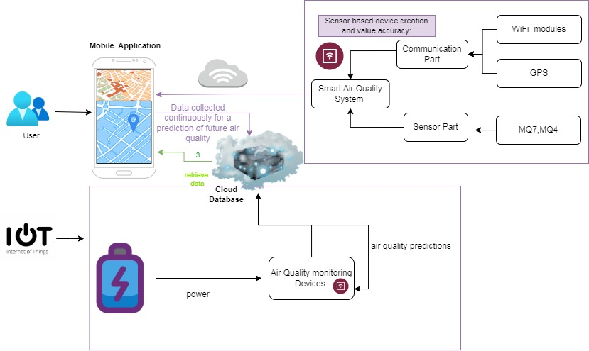
System Diagram
IT21003714 | RIMAS.M.J.M | RP24-78

Slide 19
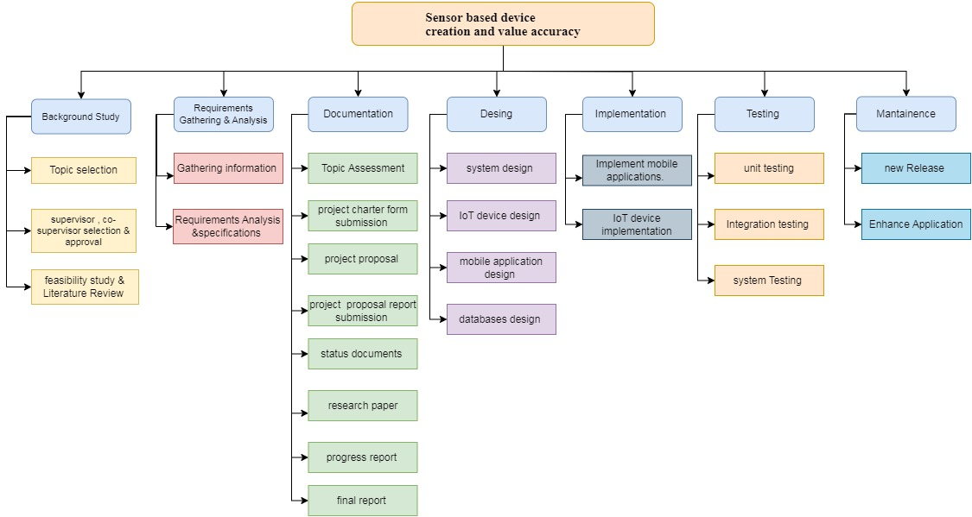
Work Breakdown Structure
IT21003714 | RIMAS.M.J.M | RP24-78

Slide 20
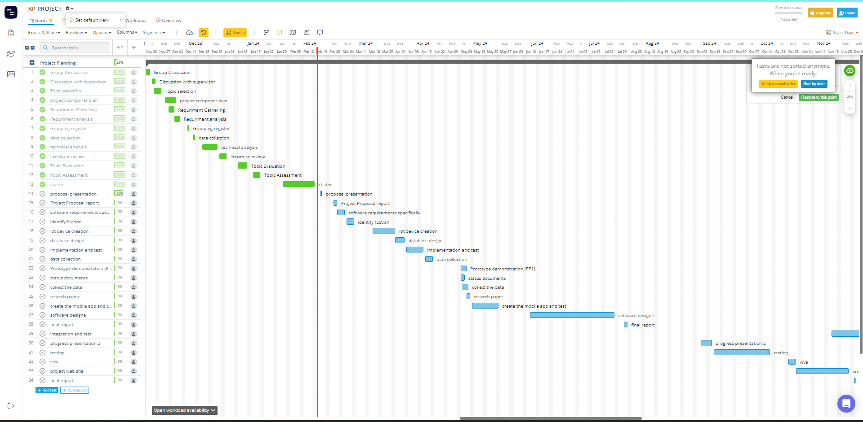
Gannt Chart
IT21003714 | RIMAS.M.J.M | RP24-78

Slide 21
Budget
Resource Type​ | Amount (USD) | Amount (LKR)
Hosting mobile App |  | Rs. 4898
MQ4, and MQ7 sensors | 1.5$+2.5$ | 495/- +752
Arduino Uno board | 9$ | 2950/-
esp8266 Wi-Fi module | 1.2$ | 395/-
MongoDB database | Free | Free
Arduino IDE | Open-source | Open-source
GPS module |  | 1,790
Total |  | 6750
IT21003714 | RIMAS.M.J.M | RP24-78
2/21/2024

Slide 22
References
[1]. Aashiq, M. N. M., Kurera, W. T. C. C., Thilekaratne, M. G. S. P., Saja, A. M. A., Rouzin, M. R. M., Neranjan, N., & Yassin, H. (2023). An IoT-based handheld environmental and air quality monitoring station. Acta IMEKO, 12(3), 1-9.
[2] P. Pal, R. Gupta, S. Tiwari, A. Sharma, IoT Based Air Pollution Monitoring System Using ARDUINO, Int. Res. J. Eng. Technol. IRJET, vol. 04, no. 10, Oct. 2017, pp. 1137–1140. Online [Accessed 26 July 2023] https://www.irjet.net/archives/V4/i10/IRJET-V4I10207.pd
[3] G. Iadarola, A. Poli, S. Spinsante, Compressed Sensing of Skin Conductance Level for IoT-based wearable sensors, 2022 IEEE Int. Instrumentation and Measurement Technology Conf. (I2MTC), Ottawa, ON, Canada, 16-19 May 2022, pp. 1-6. DOI: 10.1109/I2MTC48687.2022.9806516
[4] K. N. Genikomsakis, N.-F. Galatoulas, P. I. Dallas, L. M. Candanedo Ibarra, D. Margaritis, C. S. Ioakimidis, Development and On-Field Testing of Low-Cost Portable System for Monitoring PM2.5 Concentrations, Sensors, vol. 18, no. 4, Apr. 2018, Art. no. 4. DOI: 10.3390/s18041056
[5] E. Mehdizadeh, V. S. Kumar, J. Wilson, and S. Pourkamali, “Inertial Impaction on MEMS Balance Chips for Real-time Air Quality Monitoring,” IEEE Sens. J., vol. 17, no. 8, pp. 1–1, 2017
[6] N. A. Zakaria, Z. Zainal, N. Harum, L. Chen, N. Saleh, F. Azni, Wireless Internet of Things-Based Air Quality Device for Smart Pollution Monitoring, Int. J. Adv. Comput. Sci. Appl., vol. 9, no. 11, 2018, pp. 65–69. DOI: 10.14569/IJACSA.2018.091110
2/21/2024

Slide 23
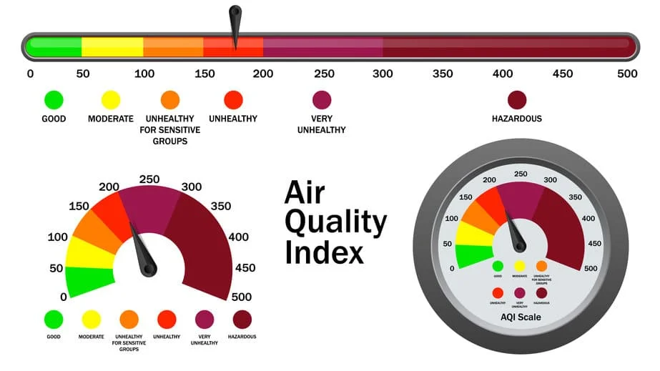
Pollution levels prediction
IT21058028 Inthikhaff M. I. M
IT21058028 | Inthikhaff. M.I.M | RP24-78

Slide 24

INTRODUCTION
This research aims to predict the Air Quality Index (AQI) in Colombo using various machine learning algorithms, including regression, support vector machines, k-nearest neighbors, and random forest. [1]
Our primary focus is on enhancing existing methods to accurately predict and understand air quality.
Colombo consistently experiences an average unhealthy AQI, making reliable predictions crucial for guiding public precautions regarding indoor and outdoor activities.[2]
IT21058028 | Inthikhaff. M.I.M | RP24-78
2/21/2024

Slide 25

INTRODUCTION
The motivation for this study stems from human actions, industrialization, and increased vehicle emissions contributing to rising air pollution[3].
The correlation between AQI and threats to human health, including short-term and long-term effects, emphasizes the importance of accurate predictions.
Colombo faces a lack of public awareness regarding air quality, highlighting the need for effective predictions to educate and safeguard the population[5].
The study utilizes a historical dataset from the Central Environment Authority (CEA) and employs machine learning models such as Random Forest, K Nearest Neighbors, Support Vector Machine, and Multiple Linear Regression for prediction accuracy[6].
IT21058028 | Inthikhaff. M.I.M | RP24-78
2/21/2024
25

Slide 26
Research Question
How datasets are going to be collected?
What algorithm going to be used to train the model?
How you make sure to get high accuracy?
IT21058028 | Inthikhaff. M.I.M | RP24-78

Slide 27
Specific and Sub Objectives
Identification of data set, cleaning and preprocessing
Training data set using different model
Air pollution level prediction and air quality Indexing
Finding best model which gives high level accuracy
Identification of Weligama Coconut Leaf Wilt Disease severity stage
Graphical and comparative visual representation
IT21058028 | Inthikhaff. M.I.M | RP24-78

Slide 28
Research Gap
Data Preprocessing Impact:
One critical aspect affecting prediction accuracy is data preprocessing.
Incomplete or inaccurate preprocessing negatively impacts the quality of predictions.
Existing Systems in Sri Lanka:
Current systems in Sri Lanka have shown limitations in providing accurate AQI predictions.
The deficiencies in existing systems highlight the need for improvement and innovation[4].
Global Comparison:
A comparative analysis with other countries reveals discrepancies.
Other nations have successfully overcome challenges and achieved higher accuracy in AQI predictions.
IT21058028 | Inthikhaff. M.I.M | RP24-78
2/21/2024
Notes:
Conclusion:
The research identifies a crucial research gap in data preprocessing methods and the overall accuracy of existing AQI prediction systems in Sri Lanka.
Bridging this gap is essential to enhance the reliability and effectiveness of air quality predictions, bringing them in line with global standards.
This slide succinctly communicates the identified research gap and emphasizes the significance of addressing these gaps in the context of AQI prediction in Sri Lanka.

Slide 29


Research Gap Summary
Identification of Air Pollution level
Progression level detection
Mobile-based identification approach
Application Reference
Predictive
Analysis
Comparative visual dynamically
First-ever mobile-based Air pollution identification with comparable visuals application in Srilanka.
Research A
Research B
Proposed System
IT21058028 | Inthikhaff. M.I.M | RP24-78
2/21/2024

Slide 30





Technologies, Techniques, Algorithms
Algorithms &
Architectures
Technologies
Techniques
The Train-Test-Split technique is so far the most frequent approach used in the cross validation of pre-processed data.
React Native
Python
TensorFlow
Kera's
Node JS
Algorithms
Random Forest
K Nearest Neighbors
Support Vector Machine and Multiple Linear Regression
(will be used to choose the best for higher accuracy)
IT21058028 | Inthikhaff. M.I.M | RP24-78
2/21/2024

Slide 31




System, Personnel, and
Software Specification Requirements
Collecting polluted air data from the emission standard publication websites and Preprocessing, Cleaning, Transforming.
Feature Selection and Analysis
Model Development Implement machine learning algorithms for pollution level prediction. Explore and select the most suitable predictive model based on performance metrics.
Dynamic Predictions for Real-time Adjustments.
Real-time Pollution Data and Comparison and Visualization
Non-Functional Requirements
Software Requirements
Functional Requirements
Interfaces should be User-friendly
Should properly work for android and IOS devices
The application should be reliable
Higher accuracy of results
Results should be more efficient
Python
Node JS
Jupyter Notebook
Intellij Idea
Visual Studio Code
Personnel Requirements
Resources and Dataset Air pollution level in Colombo
Central Environment Authority (CEA)
The National Building Research Organization (NBRO).
IT21058028 | Inthikhaff. M.I.M | RP24-78
2/21/2024

Slide 32
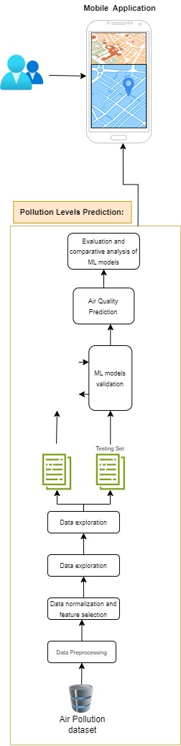
System Diagram
The proposed approach consists of a sequence of phases for predicting the AQI.
The sequence of phases includes.
Collecting the dataset from Central Environmental Authority,
Pre-processing the collected dataset.
Analyzing the collected dataset to identifying the correlations among air pollution factors.
Applying appropriate ml algorithms, & ultimately selecting the most suitable machine learning approach & analyzing the prediction results.
IT21058028 | Inthikhaff. M.I.M | RP24-78

Slide 33
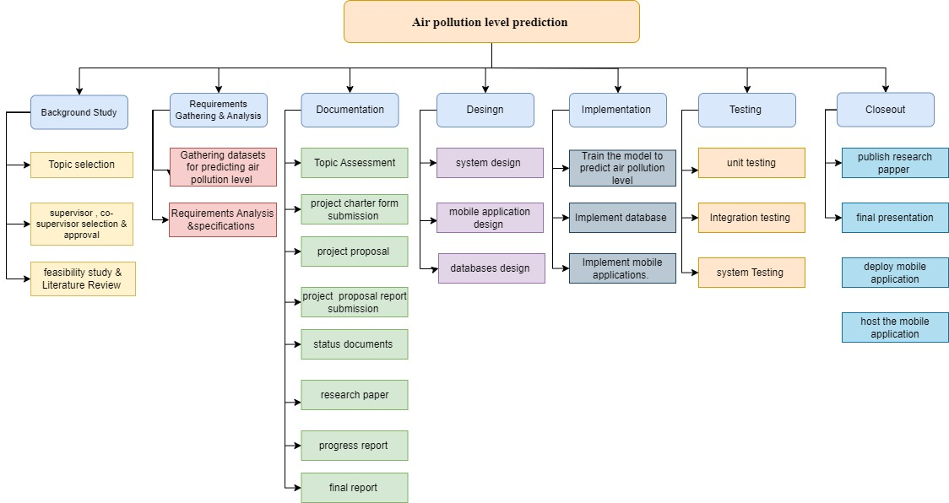
Work Breakdown Structure
IT21058028 | Inthikhaff. M.I.M | RP24-78
2/21/2024

Slide 34
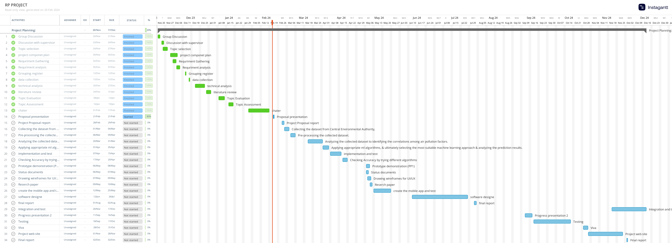
Gannt Chart
IT21058028 | Inthikhaff. M.I.M | RP24-78
2/21/2024

Slide 35
References
[1] S. Mahanta, T. Ramakrishnudu, R. R. Jha, and N.Tailor, “Urban Air Quality Prediction Using RegressionAnalysis,” in TENCON 2019 - 2019 IEEERegion 10 Conference (TENCON), Kochi, India,Oct. 2019, pp. 1118–1123. doi: 10.1109/TENCON.2019.8929517.
[2] M. Castelli, F. M. Clemente, A. Popoviˇc, S. Silva,and L. Vanneschi, “A Machine Learning Approachto Predict Air Quality in California,” Complexity,vol. 2020, pp. 1–23, Aug. 2020, doi:10.1155/2020/8049504.
[3] S. Zhong, Z. Yu, and W. Zhu, “Study of the Effectsof Air Pollutants on Human Health Based onBaidu Indices of Disease Symptoms and Air QualityMonitoring Data in Beijing, China,” IJERPH,vol. 16, no. 6, p. 1014, Mar. 2019, doi:10.3390/ijerph16061014.
[4] Y. L. S. Nandasena, A. R. Wickremasinghe, andN. Sathiakumar, “RAesierarpchoarltilculetion andhealth in Sri Lanka: a review of epidemiologic studies,”p. 14, 2010.
[5] T. Xayasouk and H. Lee, “AIR POLLUTION PREDICTIONSYSTEM USING DEEP LEARNING,”Naples, Italy, Jun. 2018, pp. 71–79. doi:10.2495/AIR180071.
[6] D. Iskandaryan, F. Ramos, and S. Trilles, “AirQuality Prediction in Smart Cities Using MachineLearning Technologies based on Sensor Data: AReview,” Applied Sciences, vol. 10, no. 7, p. 2401,Apr. 2020, doi: 10.3390/app10072401.
IT21058028 | Inthikhaff. M.I.M | RP24-78
2/21/2024

Slide 36

Component: Real-Time Pollution Map
IT21152832 | KUMARI J.M.D
BSC (HONS) DEGREE IN INFORMATION TECHNOLOGY
(SPECIALIZATION IN INFORMAITON TECHNOLOGY)
2/18/2024
IT21152832 | KUMARI J.M.D | RP24-78

Slide 37

Background
Heatmap visualize numerical data with color-coded points, which capturing different levels of pollution.
introduces a cellular GPS dynamic heatmapping device for real-time pollution mapping, emphasizing simplicity, cost-effectiveness, and data collection efficiency.
IT21152832 | KUMARI J.M.D | RP24-78

Slide 38
Research Question
How can the spatial resolution of real-time pollution maps be optimized to provide accuracy?
How can user engagement be enhanced in real-time pollution heatmap throughout the different times of the day?
What algorithms can be developed to enable real-time pollution maps to dynamically respond to sudden environmental events and provide timely and accurate information to relevant users?
IT21152832 | KUMARI J.M.D | RP24-78

Slide 39
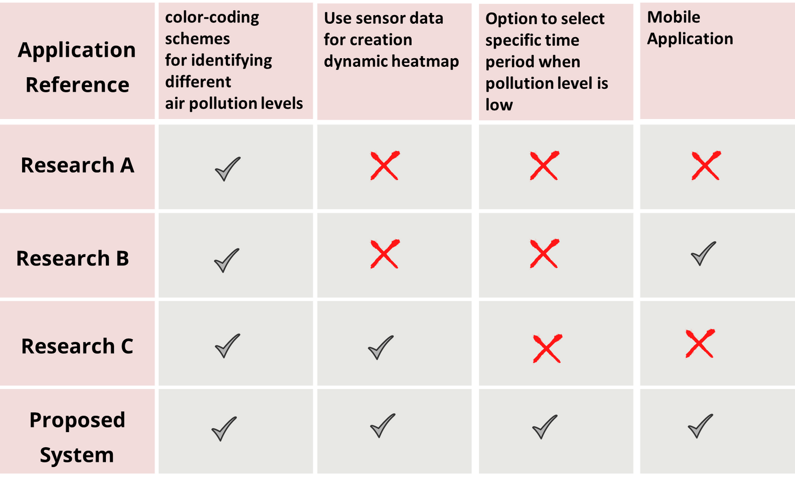
Research Gap
First-ever Mobile-based dynamic realtime time dependent pollution heatmap creation
application in Sri Lanka
IT21152832 | KUMARI J.M.D | RP24-78

Slide 40
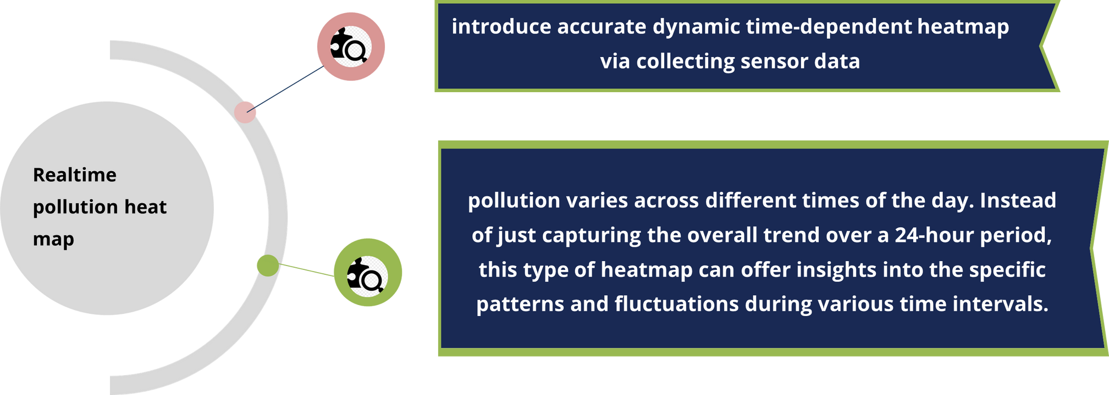
Specific and Sub Objectives
IT21152832 | KUMARI J.M.D | RP24-78

Slide 41
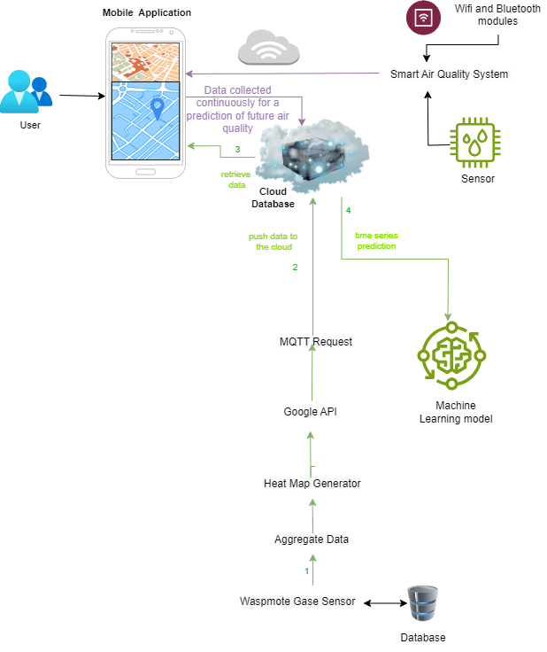
System Diagram
IT21152832 | KUMARI J.M.D | RP24-78

Slide 42
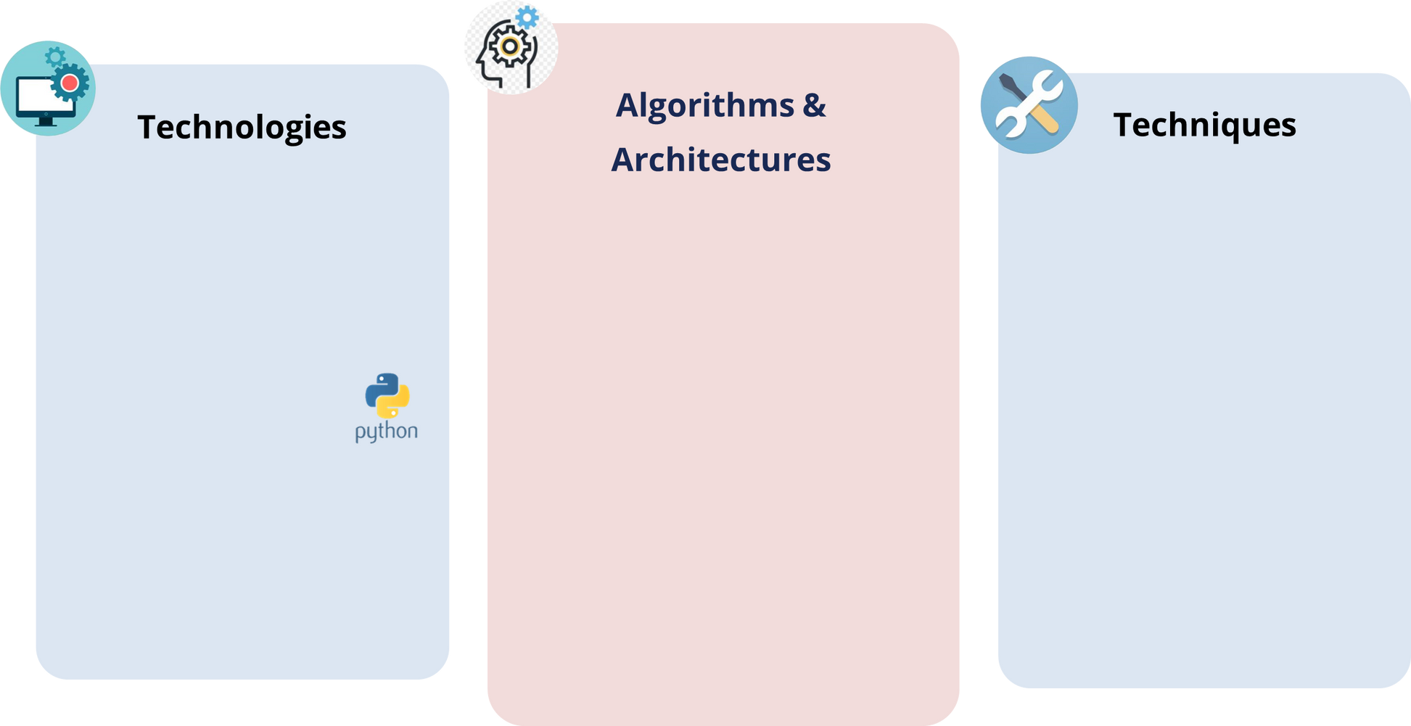
Technologies, algorithms to be used
React Native
Python
MongoDB
React Native Python MongoDB
Temporal Aggregation
Spatial Clustering
Gaussian kernel algorithm
K-nearest algorithm
Hierachical clustering
IT21152832 | KUMARI J.M.D | RP24-78

Slide 43
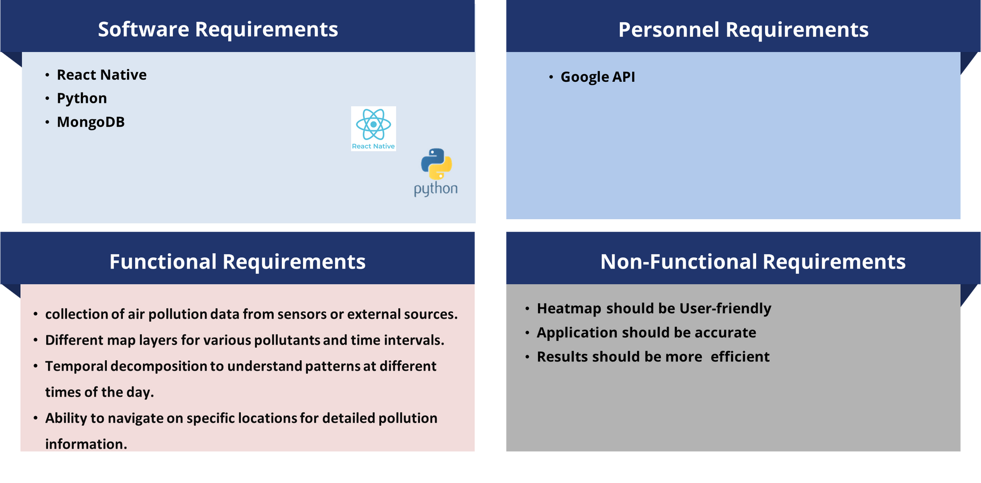

System, personal, and software specification Requirements
IT21152832 | KUMARI J.M.D | RP24-78

Slide 44
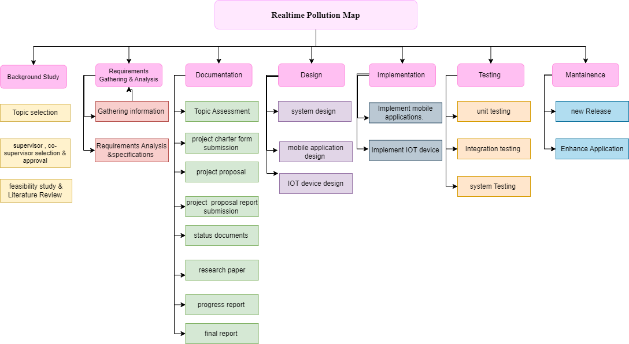
Work Breakdown Structure
IT21152832 | KUMARI J.M.D | RP24-78

Slide 45
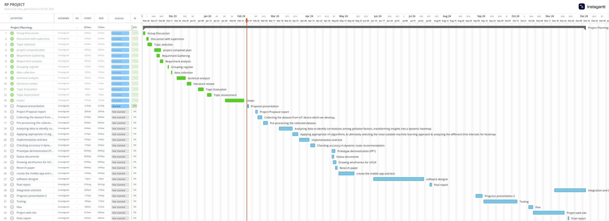
GANTT CHART
IT21152832 | KUMARI J.M.D | RP24-78

Slide 46
REFERENCES
[1] HEI International Scientific Oversight Committee, “Outdoor air pollution and health in the developing countries of Asia: a comprehensive review. Special report 18,” Heal. Eff. Institute, Bost., no. November, 2010.
[2] G. Parmar, S. Lakhani, and M. K. Chattopadhyay, “An IoT based low cost air pollution monitoring system,” Int. Conf. Recent Innov. Signal Process. Embed. Syst. RISE 2017, vol. 2018-January, pp. 524–528, 2018.
[3] I. Kousis, I. Pigliautile, and A. L. Pisello, “Intra-urban microclimate investigation in urban heat island through a novel mobile monitoring system,” Scientific Reports, vol. 11, no. 1, p. 9732, 2021
IT21152832 | KUMARI J.M.D | RP24-78

Slide 47
Real-time Route Generation Based on Pollution
Pasan M.G.R (IT21057588)

Slide 48
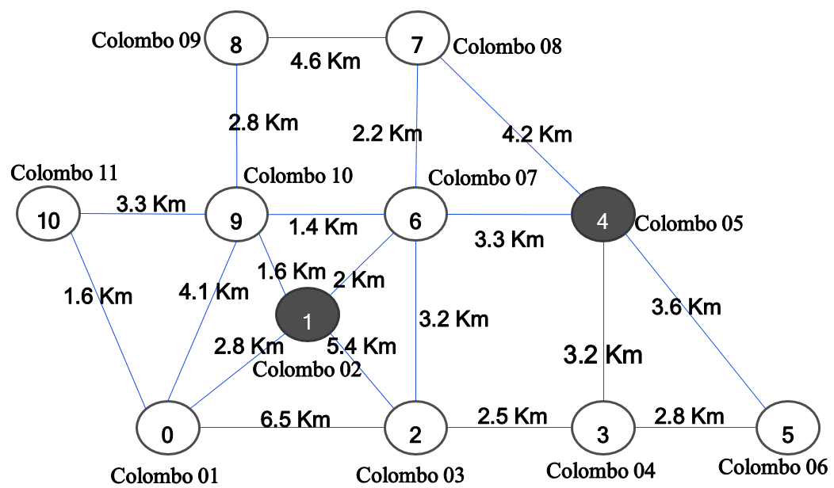
INTRODUCTION
The system suggests the best route for the client based on the air quality and the distance for a given destination.
A sample sketch that used to suggest routes is shown in Figure
These nodes represent 11 cities within the Colombo district, Sri Lanka. Before suggesting routes, the system filters the minimum polluted cities by looking at the active air quality records for the above-given cities.
IT21057588 | Pasan . M.G.R | RP24-78
2/21/2024

Slide 49
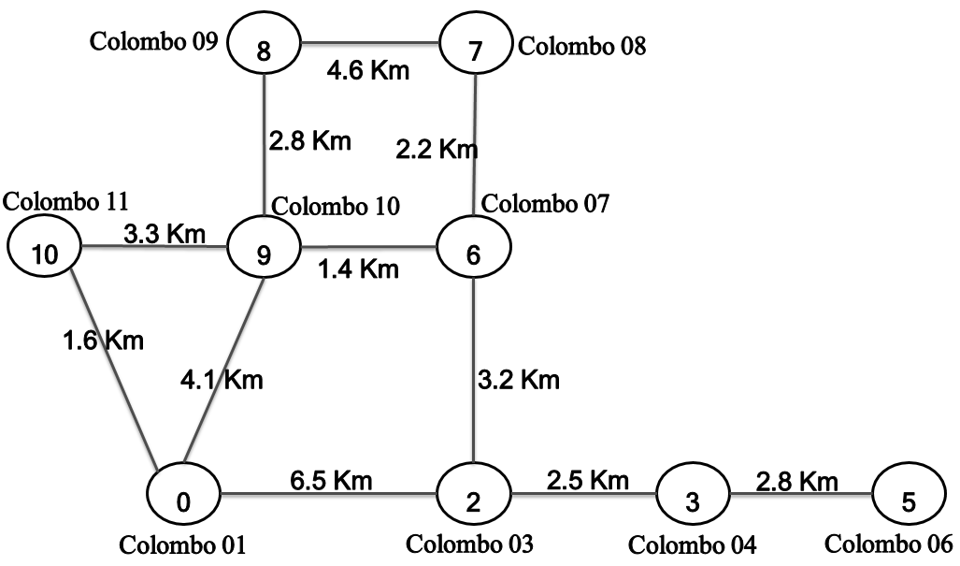
INTRODUCTION
If Node1, Node3, and Node10 are polluted, the route suggestion process will dynamically create a map by removing all polluted points that filtered as shown in Fig
IT21057588 | Pasan . M.G.R | RP24-78
2/21/2024

Slide 50
INTRODUCTION
A new algorithm has been developed by combining Dijkstra’s algorithm and the dynamic mapping process to suggest the best way.
The algorithm takes the nearest nonpolluted point for the given Start as the starting point and the nearest non-polluted point for the given destination as the endpoint for real-life applications.
Finally, the suggested points for the route are sent to the Mobile application to display it on the map.
IT21057588 | Pasan . M.G.R | RP24-78
2/21/2024

Slide 51
Research Question
How data service for accessing and processing road network information.
How is polluted route identified?
How is the Pollution Level Considered in the Route Map?
IT21057588 | Pasan . M.G.R | RP24-78

Slide 52
Research Gap
Optimization Algorithm:
Enhance the efficiency of the current algorithm, which combines Dijkstra’s algorithm and dynamic mapping, possibly exploring advanced optimization techniques.
2.Dynamic Air Quality Updates:
Integrate real-time air quality updates into the route suggestion process to ensure the information remains current throughout the journey.
3.User Preferences Integration:
Develop methods to incorporate user-specific preferences, such as preferred transportation modes, scenic routes, or personalized criteria, into the route suggestion algorithm.
4.Comprehensive Performance Evaluation:
Conduct a thorough performance analysis of the suggested routes, considering factors like travel time, energy efficiency, and user satisfaction, to validate the effectiveness of the proposed algorithm in real-world scenarios.
IT21057588 | Pasan . M.G.R | RP24-78
2/21/2024
Notes:
Conclusion:
The research identifies a crucial research gap in data preprocessing methods and the overall accuracy of existing AQI prediction systems in Sri Lanka.
Bridging this gap is essential to enhance the reliability and effectiveness of air quality predictions, bringing them in line with global standards.
This slide succinctly communicates the identified research gap and emphasizes the significance of addressing these gaps in the context of AQI prediction in Sri Lanka.

Slide 53
Research Gap Summary
Identification of Route map in Colombo
Progression level detection
Mobile-based identification approach
Application Reference
Identifying Polluted Route
Alter route with real time pollution data
First-ever in Srilanka with real time alternative route suggestion according to pollution level.
Research A
Research A
Research B
Proposed System
IT21057588 | Pasan . M.G.R | RP24-78
2/21/2024

Slide 54
Specific and Sub Objectives
Identification of Polluted Route Areas
Real-time Route Generation
Based on Pollution
Writing algorithm to calculate the near distance level low polluted route
Finding best route with low pollution level
Graphical and comparative visual representation
IT21057588 | Pasan . M.G.R | RP24-78
2/21/2024

Slide 55
Technologies, Techniques, Algorithms
Algorithms &
Architectures
Technologies
Techniques
The choice of the algorithm depends on factors such as the size of the network, real-time data availability, and the level of optimization required. Combining these algorithms intelligently can result in a robust real-time route generation system that considers both distance and pollution levels.
React Native
Python
Tensorflow
Keras
Node JS
Algorithms
Dijkstra's Algorithm
Dynamic Weighting
A Algorithm
Reinforcement Learning
(will be used to choose the best for higher accuracy)
IT21057588 | Pasan . M.G.R | RP24-78
2/21/2024

Slide 56
System, Personnel, and
Software Specification Requirements
Collecting polluted air data from the emission standard publication websites and Preprocessing, Cleaning, Transforming.
Feature Selection and Analysis
Model Development Implement machine learning algorithms for pollution level prediction. Explore and select the most suitable predictive model based on performance metrics.
Dynamic Predictions for Real-time Adjustments.
Real-time Pollution Data and Comparison and Visualization
Non-Functional Requirements
Software Requirements
Functional Requirements
Interfaces should be User-friendly
Should properly work for android and IOS devices
The application should be reliable
Higher accuracy of results
Results should be more efficient
Python
Node JS
Jupyter Notebook
Intellij Idea
Visual Studio Code
Personnel Requirements
Resources and Dataset Air pollution level in Colombo
Central Environment Authority (CEA)
The National Building Research Organization (NBRO).
IT21057588 | Pasan . M.G.R | RP24-78
2/21/2024

Slide 57
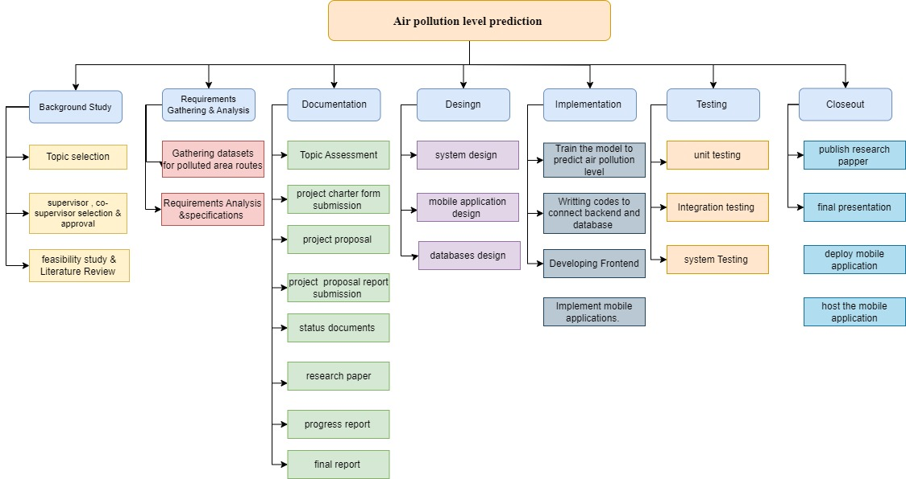
Work Breakdown Structure
IT21057588 | Pasan . M.G.R | RP24-78
2/21/2024

Slide 58
System Diagram
.
IT21057588 | Pasan . M.G.R | RP24-78
2/21/2024

Slide 59

Gannt Chart
IT21057588 | Pasan . M.G.R | RP24-78

Slide 60
References
.
IT21057588 | Pasan . M.G.R | RP24-78
2/21/2024

Slide 61

Commercialization
Can be sold as a separate module
Target Clients – People who were affected by respiratory diseases(school children's , public)
How can we promote this product?
Content based inbound marketing
Social media marketing
Industry events (expos)
Referral programs (affiliate programs)
2/21/2024

Slide 62
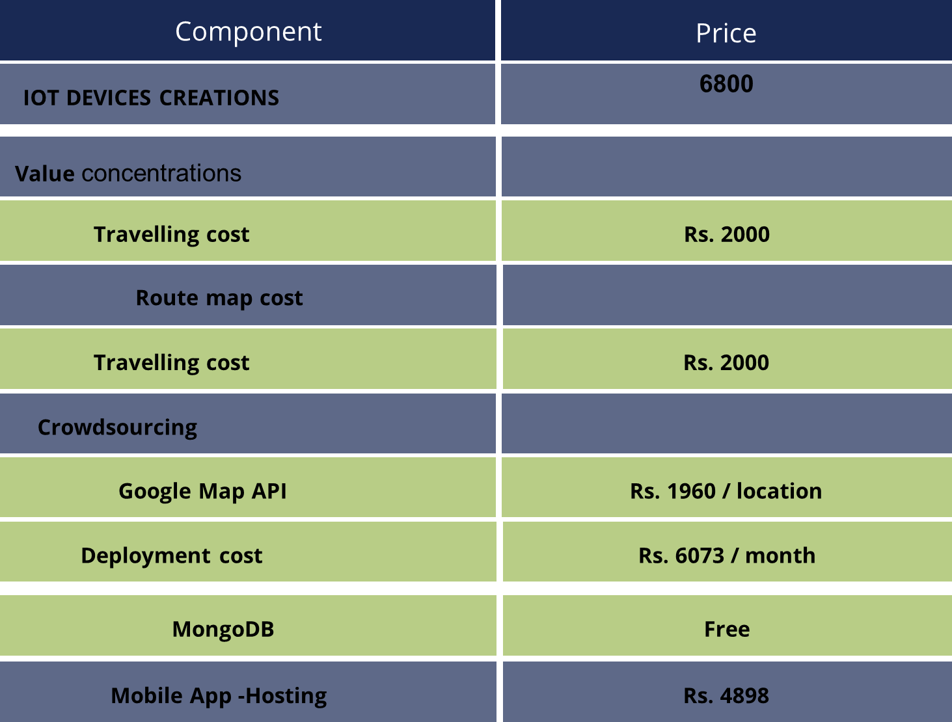
Overall Budget
.
2/21/2024

Slide 63


